Slide 1
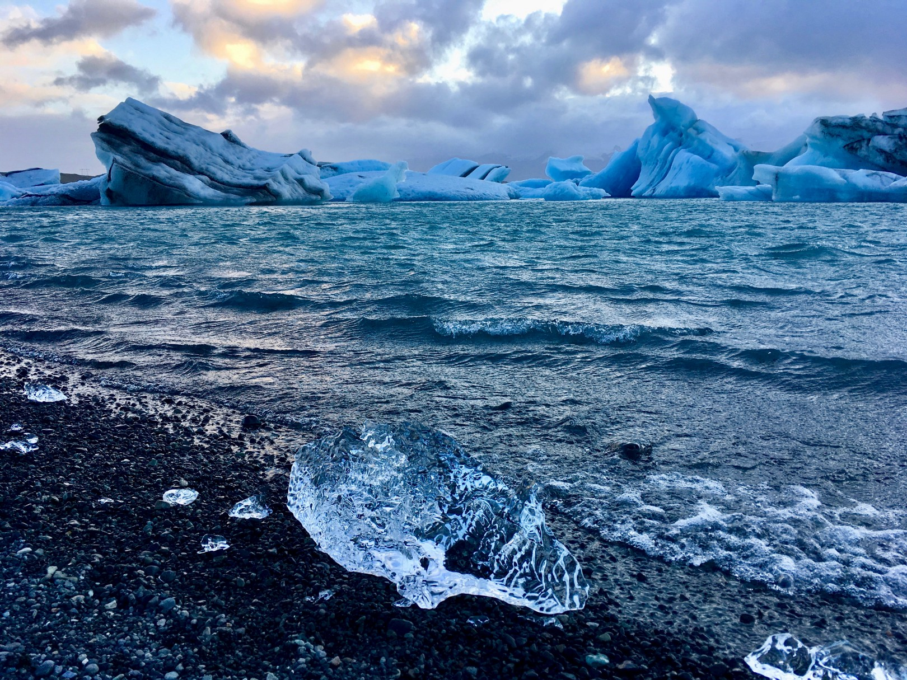
ICEBERG DETECTION USING SATELLITE IMAGES

Slide 2
Team Name: BIET-TEAM16
Nandini B
Gousiya Banu I
Harshita J R
Tejaswini Manne
Rakshitha T M

Slide 3
Index
Road Map
Introduction
Data Collection
Data Preprocessing
Model Design
Application Design
Advantages and Disadvantages
Conclusion

Slide 4
Introduction
Icebergs present serious hazards for ship navigation and offshore installations. Consequently, there is a large interest to localize them timely and over vast areas. Because of their independence of cloud cover and daylight, satellite Synthetic Aperture Radar (SAR) images are among the preferred data sources for operational ice conditions and iceberg occurrences. The image spatial resolution mostly used for iceberg monitoring varies between a few and 100 m. Processed SAR data are characterized by speckle noise, which causes a grainy appearance of the images making the identification of icebergs extremely difficult. The methods of satellite monitoring of dangerous ice formations, like icebergs in the Arctic seas represent a threat to the safety of navigation and economic activity on the Arctic shelf.

Slide 5
Road Map
2.Data
Collection
4.Model
Design
3.Data
Pre-processing
1.Work
Distribution
5.Application
Design

Slide 6
Data Collection
We have used iceberg and ship dataset from Kaggle provided in the description of the problem.

Slide 7
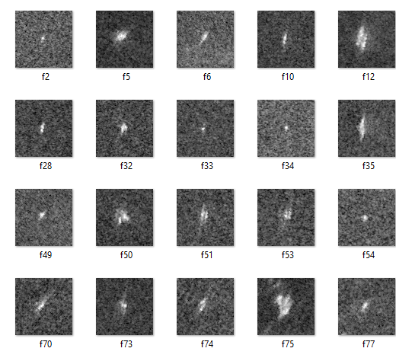
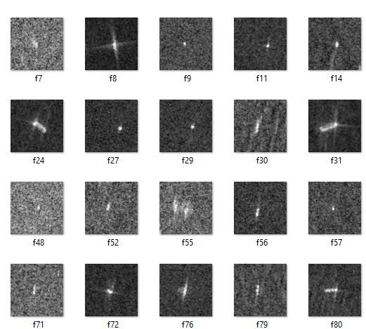
ICEBRG SHIP

Slide 8
Data pre-processing
Step 1: Importing ImageDataGenerator library
Step2:Configuring ImageDataGenerator class
Step3 : Applying ImageDataGenerator Functionality to Trainset and Testset

Slide 9
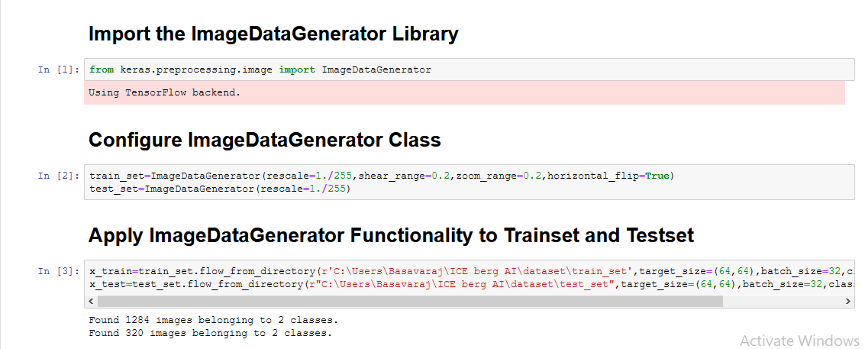

Slide 10
Model Design
Step 1: We have used the Keras Sequential API, where we have to add one layer at a time, starting from the input
Step 2: Adding convolutional (Conv2D) layer. It is like a set of learnable filters. We chose to set 32 filters for the two firsts conv2D layers and 64 filters for the two last ones. Each filter transforms a part of the image (defined by the kernel size) using the kernel filter. The kernel filter matrix is applied on the whole image. Filters can be seen as a transformation of the image.
Step 3: Adding the second important layer in CNN is the pooling (MaxPool2D) layer. This layer simply acts as a downsampling filter. It looks at the 2 neighbouring pixels and picks the maximal value. These are used to reduce computational cost, and to some extent also reduce overfitting.

Slide 11
Model Design
Step 4- Adding the Flatten layer is use to convert the final feature maps into a one single 1D vector. This flattening step is needed so that you can make use of fully connected layers after some convolutional/maxpool layers.
Step 5:In the end we used the features in two fully-connected (Dense) layers which is just artificial an neural networks (ANN) classifier.
Step 6: Once layers are added to the model, we need to set up a score function, a loss function and an optimisation algorithm and compile the model.
Step 7:Fit the model into x_train ,y_train and finally save the model.

Slide 12
Application Design
We have used HTML ,CSS for front end and flask for backend.

Slide 13
Advantages and Disadvantages
Advantages:
We are able to detect icebergs in an image,so,that it would be of great help to the logistics and transportation team.
It could bring a whole new dimension of transport for container ships and vessels by tracking icebergs from satellite images in real-time.
Iceberg detection is easy to implement and understand.
It operate in real-time due to low time complexity.
Disadvantages:
The time between ground tracking and the repeat cycle. This means that the system is not responsive enough to track small or complex iceberg situations.
A different satellite may pass over the region a few days later its cargo maybe a different sensor, hardware and software that will produce different imagery and can produce different results.

Slide 14
Conclusion
This is one of the great examples where deep learning can be used to solve a challenging real-world problem. If we are able to detect and segment icebergs in an image, it would be of great help to the logistics and transportation team in northern countries like Sweden, Norway and Canada. It could bring a whole new dimension of transport for container ships and vessels by tracking icebergs from satellite images and videos in real-time.

